Slide 1

CHAPTER 4 Threads and SMP
Instructor: Wuman LUO
luowuman@ipm.edu.mo
Office: A213
14:30-17:30 Tuesday & Wednesday

Slide 2
What We Will Learn
Multithreading
Process vs. Thread
Process image in multithreaded process
Thread Control Block (TCB)
Thread switching
Benefits of threads
Symmetric multiprocessing (SMP)

Slide 3
Process
Each process
has some resources allocated by OS, including memory to hold the process image
follows an execution path that may be interleaved with other processes (thread of execution)

Slide 4
Process Image
Process image in RAM
Each process is allocated some resources, including the memory to hold the process image.
program
data
int doub(int i)
{ return i*2; }
int b;
void main () {
int a=3;
b = doub(a+1);
printf(“done”);
}
“done”
b
stack
For two processes A and B:
Process A cannot access the memory of process B.
Process A and B cannot share data in memory.
ret
i
4
PCB
a
3
state
…
AX
…
PC
…

Slide 5
Single-Threaded Execution
Process image in RAM
Each process has one thread of execution. At any time, only one instruction is being executed.
program
data
int doub(int i)
{ return i*2; }
int b;
void main () {
int a=3;
b = doub(a+1);
printf(“done”);
}
“done”
b
stack
➔
The arrow indicates the current instruction being executed. Its relation with the register PC and the PC value in the PCB is illustrated in the last example of Chap 3. Also notice how the stack changes in the course of execution.
PCB
a
3
state
…
AX
…
PC
…

Slide 6
Single-Threaded Execution
Process image in RAM
Each process has one thread of execution. At any time, only one instruction is being executed.
program
data
int doub(int i)
{ return i*2; }
int b;
void main () {
int a=3;
b = doub(a+1);
printf(“done”);
}
“done”
b
stack
The arrow indicates the current instruction being executed. Its relation with the register PC and the PC value in the PCB is illustrated in the last example of Chap 3. Also notice how the stack changes in the course of execution.
➔
PCB
a
3
state
…
AX
…
PC
…

Slide 7
Single-Threaded Execution
Process image in RAM
Each process has one thread of execution. At any time, only one instruction is being executed.
program
data
int doub(int i)
{ return i*2; }
int b;
void main () {
int a=3;
b = doub(a+1);
printf(“done”);
}
“done”
➔
b
stack
The arrow indicates the current instruction being executed. Its relation with the register PC and the PC value in the PCB is illustrated in the last example of Chap 3. Also notice how the stack changes in the course of execution.
ret
i
4
PCB
a
3
state
…
AX
…
PC
…

Slide 8
Single-Threaded Execution
Process image in RAM
Each process has one thread of execution. At any time, only one instruction is being executed.
program
data
int doub(int i)
{ return i*2; }
int b;
void main () {
int a=3;
b = doub(a+1);
printf(“done”);
}
“done”
b
8
stack
The arrow indicates the current instruction being executed. Its relation with the register PC and the PC value in the PCB is illustrated in the last example of Chap 3. Also notice how the stack changes in the course of execution.
➔
PCB
a
3
state
…
AX
…
PC
…

Slide 9
Single-Threaded Execution
Process image in RAM
Each process has one thread of execution. At any time, only one instruction is being executed.
program
data
int doub(int i)
{ return i*2; }
int b;
void main () {
int a=3;
b = doub(a+1);
printf(“done”);
}
“done”
b
8
stack
The arrow indicates the current instruction being executed. Its relation with the register PC and the PC value in the PCB is illustrated in the last example of Chap 3. Also notice how the stack changes in the course of execution.
➔
PCB
a
3
state
…
AX
…
PC
…

Slide 10
Single-Threaded Execution
Process image in RAM
Each process has one thread of execution. At any time, only one instruction is being executed.
program
data
int doub(int i)
{ return i*2; }
int b;
void main () {
int a=3;
b = doub(a+1);
printf(“done”);
}
“done”
b
8
stack
The arrow indicates the current instruction being executed. Its relation with the register PC and the PC value in the PCB is illustrated in the last example of Chap 3. Also notice how the stack changes in the course of execution.
➔
PCB
state
…
AX
…
PC
…

Slide 11
Multithreading
Multithreading vs. Multiprogramming
Multiple threads of execution within a single process
Notes:
Multiprogramming enables the interleaving of multiple threads within multiple processes.

Slide 12
OS Support for Threads and Processes
one process one thread e.g. MS-DOS
one process
multiple threads e.g. JVM
multiple processes
one thread per process e.g. traditional Unix
multiple processes
multiple threads per process e.g. Windows 2000, Solaris, Mac OS X, BeOS, Linux, OS/390
Notes:
Java runtime environment: JVM (Java Virtual Machine)

Slide 13
Process vs. Thread
A process has one or more threads
Process – Unit of resource ownership
Some resources allocated by OS, including memory, open files
Thread – Unit of dispatching
an execution path
execution may be interleaved with other threads / processes

Slide 14
Multithreading – An Example
Process ThdDemo
procedure TQuickSort.Sort(var A: array of Integer);
var
I, J
begin
for I
for
if
b
e
end;
When we run the program thddemo.exe, we create a process which consists of three threads: one thread for each sort procedure.
procedure TBubbleSort.Sort(var A: array of Integer);
var
I, J,
begin
for I
for
if
b
e
end;
procedure TSelectionSort.Sort(var A: array of Integer);
var
I, J, T: Integer;
begin
for I := Low(A) to High(A) - 1 do
for J := High(A) downto I + 1 do
if A[I] > A[J] then
begin
VisualSwap(A[I], A[J], I, J);
T := A[I];
A[I] := A[J];
A[J] := T;
if Terminated then Exit;
end;
end;
➔
➔
➔
Actually, there is one more thread, the primary thread, in the process thddemo.

Slide 15
Thread as Unit of Dispatching
Process ThdDemo
The OS schedules the three threads. Each thread is dispatched in turn, one at a time. The three threads of the process appear to be running ‘at the same time’.
procedure TQuickSort.Sort(var A: array of Integer);
var
I, J
begin
for I
for
procedure TBubbleSort.Sort(var A: array of Integer);
var
I, J,
begin
for I
for
➔
procedure TSelectionSort.Sort(var A: array of Integer);
var
I, J, T: Integer;
begin
for I := Low(A) to High(A) - 1 do
for J := High(A) downto I + 1 do
… …
➔
➔
In Chap 3, the “process ball” that represents a process is in fact the single thread within the processes. And process switching is in fact thread switching.

Slide 16
Process as Unit of Resource Ownership
Process Image of process thddemo
Program
Data
Stack
procedure TQuickSort.Sort
… ...
Global variables, constant, etc
The three threads belong to a single process, which owns resources. They share memory, opened files and I/O resources. Only a copy of the program is stored. The three threads use the same copy of global variables.
procedure TBubbleSort.Sort
… ...
procedure TSelectionSort.Sort
… ...
begin { begin }
…
end.
Process thddemo

Slide 17
Stack and PCB in Multithreaded Process
Process Image of process thddemo
Program
Data
Stack
ret
4
3
ret
2
TCB
1
ret
6
PCB
TCB
8
5
TCB
We see that a single copy of program and data are shared by the multiple threads of a multithreaded process. However, a single stack and a PCB is not sufficient.

Slide 18
Each Thread Needs a User Stack
Process Image of process thddemo
Program
Data
Stack
ret
4
3
ret
2
1
ret
6
8
5
Stack stores local variables in function call. Since each thread can run independently, their local variables appear and disappear in any order. We cannot use a single stack for multiple threads. Instead, each thread has its own stack.

Slide 19
PCB, TCB
Process Image of process thddemo
TCB of thread
Program
Data
Stack
state
ready
AX
ret
PC
4
3
ret
2
TCB of thread
TCB
1
ret
6
state
ready
PCB
TCB
8
AX
5
TCB
PC
Each thread has its own state and thread context (the value of the CPU registers last time this thread is executed). Hence, a PCB alone is not sufficient. The state and context of each thread are stored in the Thread Control Block (TCB) of the thread. PCB stores information related to the whole process.
TCB of thread
state
running
AX
PC

Slide 20
Splitting the PCB in Chap 3
Process Identification:
Process ID, User ID , Thread ID
Processor State Information
Process Control Information
scheduling and state information
data structuring
interprocess communication
process privileges
memory management
resource ownership and utilization
P
T
T
T
P
T
P
T
P
P
P
P
P

Slide 21
Single Threaded vs. Multithreaded Process Models
In multithreaded process model, the OS keeps a Thread Control Block (TCB) for each thread. Much content of the original PCB in Chap 3 is moved to TCB for each thread. Each thread has a TCB and a stack.
Process Control Block
stack
Program
Data
Process image in a single-threaded
process
Process Control Block
Thread Control Block
Thread Control Block
Process image in a multithreaded
process
Program
Data
stack
stack

Slide 22
Creation and Termination
Usually, a process is created with a single thread (called primary thread in Windows) This thread may create more threads.
A process terminates when
in Windows: the primary thread terminates
in Unix: all threads of the process terminate

Slide 23

Activities similar to Processes
Threads have execution states and may synchronize with one another.
Similar to processes
We look at these two aspects of thread functionality in turn.
States
Synchronisation (Chapter 5)

Slide 24
Thread Execution States
Key states for a thread
Running
Ready
Blocked
Operations associated with a change in thread state
Spawn (another thread)
Block
Issue: whether the blocking of a thread results in the blocking of the entire process?
Unblock
Finish (thread)
De-allocate register context and stacks
What about ‘Suspended’ state?
Notes:
Clearly, some of the flexibility and power of threads is lost if the one blocked thread blocks an entire process.
We will return to this issue subsequently in our discussion of user-level versus kernel-level threads, but for now, let us consider the performance benefits of threads that do not block an entire process.

Slide 25
Thread Suspend State?
Suspending a process involves suspending all threads of the process WHY?
It does NOT make sense to associate suspend states with threads WHY?
Notes:
Generally, it does not make sense to associate suspend states with threads because such states are process-level concepts. In particular, if a process is swapped out, all of its threads are necessarily swapped out because they all share the address space of the process.

Slide 26
Thread Synchronization
It is necessary to synchronize the activities of the various threads
all threads of a process share the same address space and other resources
any alteration of a resource by one thread affects the other threads in the same process
E.g., if two threads each try to add an element to a doubly linked list at the same time, one element may be lost or the list may end up malformed
More on this in Chapter 5

Slide 27
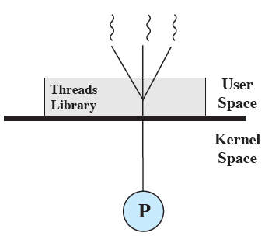
User-Level Threads (ULTs)
One of the two types of threads
All thread management is done by the application
The kernel is NOT aware of the existence of threads
Any application can be programmed to be multithreaded by using a threads library, which is a package of routines for ULT management. The threads library contains code for creating and destroying threads, for passing messages and data between threads, for scheduling thread execution, and for saving and restoring thread contexts.
Notes:
USER-LEVEL THREADS
In a pure ULT facility, all of the work of thread management is done by the application and the kernel is not aware of the existence of threads. Figure 4.5a illustrates the pure ULT approach. Any application can be programmed to be multithreaded by using a threads library, which is a package of routines for ULT management. The threads library contains code for creating and destroying threads, for passing messages and data between threads, for scheduling thread execution, and for saving and restoring thread contexts.
By default, an application begins with a single thread and begins running in that thread. This application and its thread are allocated to a single process managed by the kernel. At any time that the application is running (the process is in the Running state), the application may spawn a new thread to run within the same process. Spawning is done by invoking the spawn utility in the threads library. Control is passed to that utility by a procedure call. The threads library creates a data structure for the new thread and then passes control to one of the threads within this process that is in the Ready state, using some scheduling algorithm. When control is passed to the library, the context of the current thread is saved, and when control is passed from the library to a thread, the context of that thread is restored. The context essentially consists of the contents of user registers, the program counter, and stack pointers.

Slide 28
Example of the Relationship Between User-Level Thread and Process States
Thread 2 (T2) makes a blocking I/O call → kernel invokes I/O → places Process (P) to blocked state
The T library maintains T2 in running state
Suppose that process B is executing in its thread 2; the states of the process and the two ULTs are shown
Clock interrupt → moves to kernel → time slot for P is over → places P to ready state
The T library maintains T2 in running state
T2 is waiting data from T1 → T2 is blocked and T1 becomes ready
Kernel is not invoked → state of P is unchanged
Notes:
All of the activity described in the preceding paragraph takes place in user space and within a single process. The kernel is unaware of this activity. The kernel continues to schedule the process as a unit and assigns a single execution state (Ready, Running, Blocked, etc.) to that process. The following examples should clarify the relationship between thread scheduling and process scheduling. Suppose that process B is executing in its thread 2; the states of the process and two ULTs that are part of the process are shown in Figure 4.6a . Each of the following is a possible occurrence:
1. The application executing in thread 2 makes a system call that blocks B. For example, an I/O call is made. This causes control to transfer to the kernel. The kernel invokes the I/O action, places process B in the Blocked state, and switches to another process. Meanwhile, according to the data structure maintained by the threads library, thread 2 of process B is still in the Running state. It is important to note that thread 2 is not actually running in the sense of being executed on a processor; but it is perceived as being in the Running state by the threads library. The corresponding state diagrams are shown in Figure 4.6b .
2. A clock interrupt passes control to the kernel and the kernel determines that the currently running process (B) has exhausted its time slice. The kernel places process B in the Ready state and switches to another process. Meanwhile, according to the data structure maintained by the threads library, thread 2 of process B is still in the Running state. The corresponding state diagrams are shown in Figure 4.6c .
3. Thread 2 has reached a point where it needs some action performed by thread 1 of process B. Thread 2 enters a Blocked state and thread 1 transitions from Ready to Running. The process itself remains in the Running state. The corresponding state diagrams are shown in Figure 4.6d .
In cases 1 and 2 ( Figures 4.6b and 4.6c ), when the kernel switches control back to process B, execution resumes in thread 2. Also note that a process can be interrupted, either by exhausting its time slice or by being preempted by a higher priority process, while it is executing code in the threads library. Thus, a process may be in the midst of a thread switch from one thread to another when interrupted. When that process is resumed, execution continues within the threads library, which completes the thread switch and transfers control to another thread within that process.

Slide 29

Advantages of ULTs
Thread switching does not require kernel mode privileges
Scheduling can be application specific
ULTs can run on any OS
Notes:
There are a number of advantages to the use of ULTs instead of KLTs, including the following:
1. Thread switching does not require kernel mode privileges because all of the thread management data structures are within the user address space of a single process. Therefore, the process does not switch to the kernel mode to do thread management. This saves the overhead of two mode switches (user to kernel; kernel back to user).
2. Scheduling can be application specific. One application may benefit most from a simple round-robin scheduling algorithm, while another might benefit from a priority-based scheduling algorithm. The scheduling algorithm can be tailored to the application without disturbing the underlying OS scheduler.
3. ULTs can run on any OS. No changes are required to the underlying kernel to support ULTs. The threads library is a set of application-level functions shared by all applications.

Slide 30

Disadvantages of ULTs
In a typical OS, many system calls are blocking
when a ULT executes a system call, all of the threads within the process are blocked
In a pure ULT strategy, a multithreaded application cannot take advantage of multiprocessing
A kernel assigns one process to only one processor at a time
We have application-level multiprogramming within a single process
Applications would benefit from the ability to execute portions of code simultaneously

Slide 31
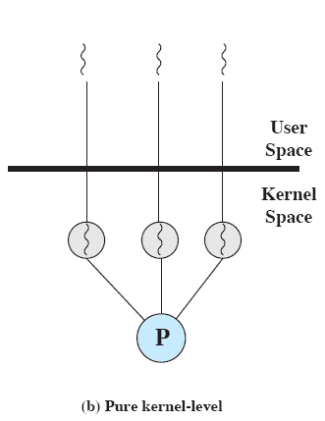
Kernel-Level Threads (KLTs)
Thread management is done by the kernel
No thread management is done by the application
Windows is an example of this approach
The kernel maintains context information for
The process as a whole, and
The individual threads within the process
Scheduling by the kernel is done on a thread basis
Notes:
KERNEL-LEVEL THREADS
In a pure KLT facility, all of the work of thread management is done by the kernel. There is no thread management code in the application level, simply an application programming interface (API) to the kernel thread facility. Windows is an example of this approach. Figure above depicts the pure KLT approach. The kernel maintains context information for the process as a whole and for individual threads within the process.

Slide 32

Advantages of KLTs
The kernel can simultaneously schedule multiple threads from the same process on multiple processors
If one thread in a process is blocked, the kernel can schedule another thread of the same process
Kernel routines themselves can be multithreaded
Notes:
Overcomes the two principal drawbacks of the ULT approach.

Slide 33
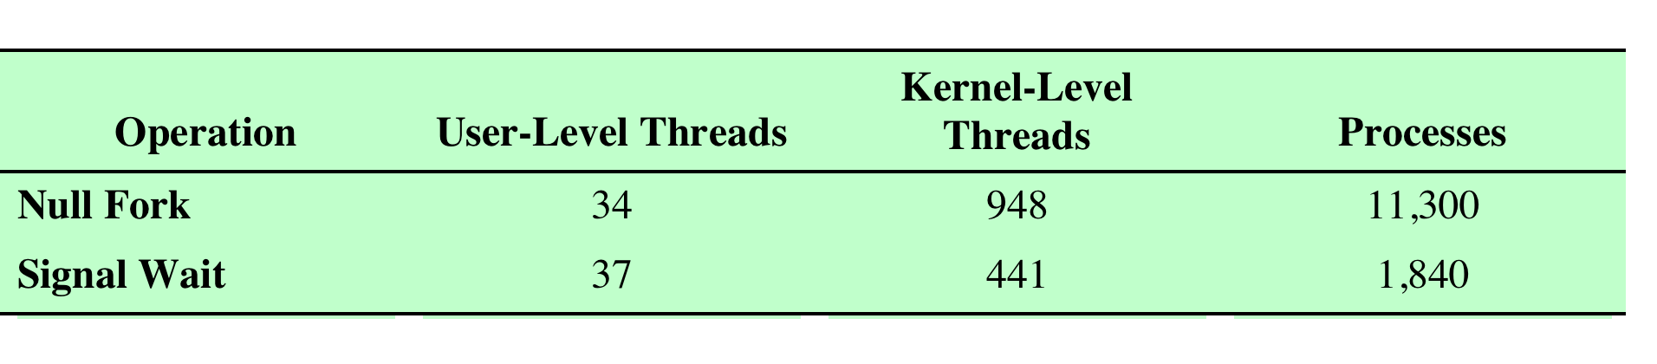

Disadvantage of KLTs
The transfer of control from one thread to another within the same process requires a mode switch to the kernel
Uniprocessor VAX Computer Running a UNIX-Like OS
Null Fork: the time to create, schedule, execute, and complete a process/thread that invokes the null procedure (i.e., the overhead of forking a process/thread)
Signal-Wait: the time for a process/thread to signal a waiting process/thread and then wait on a condition (i.e., the overhead of synchronizing two processes/threads together)
Notes:
We see that there is an order of magnitude or more of difference between ULTs and KLTs and similarly between KLTs and processes.
Thus, on the face of it, while there is a significant speedup by using KLT multithreading compared to single-threaded processes, there is an additional significant speedup by using ULTs. However, whether or not the additional speedup is realized depends on the nature of the applications involved. If most of the thread switches in an application require kernel-mode access, then a ULT-based scheme may not
perform much better than a KLT-based scheme.

Slide 34
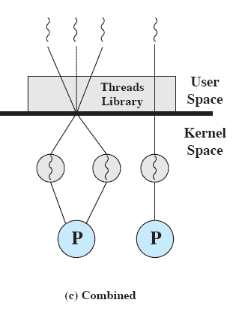
Combined Approaches
Thread creation is done in the user space
Bulk of scheduling and synchronization of threads is also done by the application
The multiple ULTs from a single application are mapped onto some (smaller or equal) number of KLTs
Solaris is an example
Notes:
COMBINED APPROACHES
Some operating systems provide a combined ULT/ KLT facility. In a combined system, thread creation is done completely in user space, as is the bulk of the scheduling and synchronization of threads within an application. The multiple ULTs from a single application are mapped onto some (smaller or equal) number of KLTs. The programmer may adjust the number of KLTs for a particular application and processor to achieve the best overall results. In a combined approach, multiple threads within the same application can run in parallel on multiple processors, and a blocking system call need not block the entire process. If properly designed, this approach should combine the advantages of the pure ULT and KLT approaches while minimizing the disadvantages. Solaris is a good example of an OS using this combined approach. The current Solaris version limits the ULT/KLT relationship to be one-to-one.

Slide 35

Summary – Process
Have a virtual address space which holds the process image, which contains:
program and data
one stack per thread
PCB and one TCB per thread
Protected access to memory, files, and I/O resources
A process has one or more threads

Slide 36
Summary – Thread (1/2)
Has an execution state
Running, ready, blocked, …
Has an execution stack
Thread context is saved and restored in thread switching
Read the following slides for how to change the steps of process switching to the steps of thread switching

Slide 37
Summary – Thread (2/2)
Has access to the memory and resources of its process
Has some per-thread static storage for local variables

Slide 38
Thread Switch – Steps
Consists of the following steps
Save processor state (incl. program counter and other registers) in the TCB: processor state information
Update the TCB with the new state and any accounting information
Move the TCB to appropriate queue – ready, blocked
Select another thread for execution
Update the TCB of the thread selected (new state and accounting information)
Update memory-management data structures
Restore context of the selected thread
restore the previous value of the program counter and other registers from the TCB
Notes:
Memory management: This section may include pointers to segment and/or page tables that describe the virtual memory assigned to
this process.
• Allocation of address space to processes
• Swapping
• Page and segment management

Slide 39
Thread Switch – Steps (Simplified)
Thread switching from thread A to thread B
Save thread context of thread A: CPU ⇨ TCB A
Update state in TCB A
Move TCB A to appropriate queue
Select another thread (thread B)
Update state in TCB B
Update memory-management data structures
Restore thread context of thread B: TCB B ⇨ CPU

Slide 40

Benefits of Threads
Less time to create / terminate a new thread than a process
Less time to switch between two threads within the same process
Communication among threads of the same process is easier

Slide 41
Benefits of Threads – 1
Less time to create / terminate a new thread than a process
When the OS creates a process, it has to allocate memory for the process image, load the program and data, and initialize other resources
When the OS creates a thread within an existing process, it does not need to initialize the process image. It only needs to set up a stack and TCB for the new thread.

Slide 42
Benefits of Threads – 2
Less time to switch between two threads within the same process
The “update memory management data structure” step is only necessary in case of thread switching between different process. (Why?)

Slide 43
Benefits of Threads – 3
Communication among threads of the same process is easier
Threads within a process share memory and files
Different processes have to communicate with the help of the kernel
Kernel is the core of OS

Slide 44
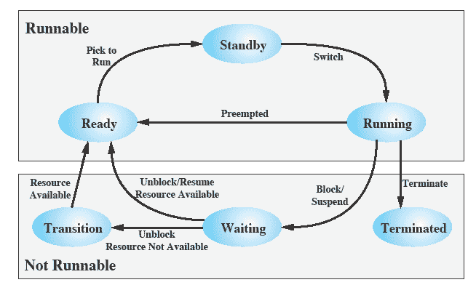
Example: Windows Thread States
Notes:
An existing Windows thread is in one of six states:
Ready: a ready thread may be scheduled for execution. The Kernel dispatcher keeps track of all ready threads and schedules them in priority order.
Standby: a standby thread has been selected to run next on a particular processor. The thread waits in this state until that processor is made available. If the standby thread’s priority is high enough, the running thread on that processor may be preempted in favor of the standby thread. Otherwise, the standby thread waits until the running thread blocks or exhausts its time slice.
Running: once the Kernel dispatcher performs a thread switch, the standby thread enters the Running state and begins execution and continues execution until it is preempted by a higher-priority thread, exhausts its time slice, blocks, or terminates. In the first two cases, it goes back to the Ready state.
Waiting: A thread enters the Waiting state when
it is blocked on an event (e.g., I/O)
it voluntarily waits for synchronization purposes, or
an environment subsystem directs the thread to suspend itself.
When the waiting condition is satisfied, the thread moves to the Ready state if all of its resources are available.
Transition: A thread enters this state after waiting if it is ready to run but the resources are not available. For example, the thread’s stack may be paged out of memory. When the resources are available, the thread goes to the Ready state.
Terminated: A thread can be terminated by itself, by another thread, or when its parent process terminates. Once housekeeping chores are completed, the thread is removed from the system, or it may be retained by the Executive for future re-initialization.
Executive: it contains the base operating system services, such as memory management, process and thread management, security, I/O, and inter-process communication.

Slide 45
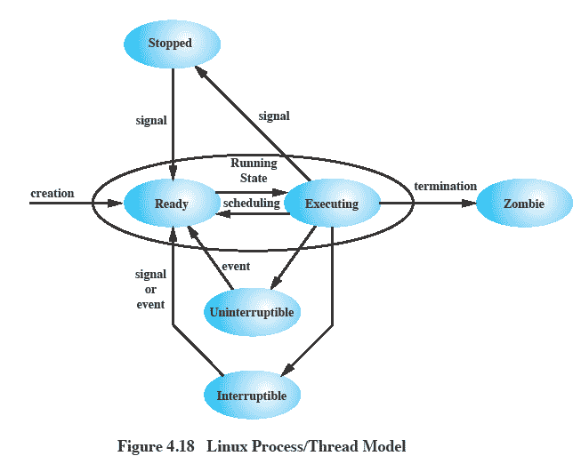
Example: Linux Process/Thread Model
Notes:
Running:
Corresponds to two states.
A Running process is either executing or
it is ready to execute.
Interruptible:
A blocked state, in which the process is waiting for an event, such as the end of an I/O operation, the availability of a resource, or a signal from another process.
Uninterruptible:
Another blocked state.
The difference between the Interruptible state is that in this state, a process is waiting directly on hardware conditions and therefore will not handle any signals.
Stopped:
The process has been halted and can only resume by positive action from another process.
E.G., a process that is being debugged can be put into the Stopped state.
Zombie:
The process has been terminated but, for some reason, still must have its task structure in the process table.

Slide 46
Symmetric Multiprocessors (SMP)
A stand-alone computer system with the following characteristics:
Two or more similar processors of comparable capability
Processors share the same main memory and are interconnected by a bus or other internal connection scheme
Processors share access to I/O devices
All processors can perform the same functions
The system is controlled by an integrated operating system that provides interaction between processors and their programs at the job, task, file, and data element levels (compared with cluster)
Multiprocessing - more than one processors in a machine
Notes:
An SMP can be defined as a stand-alone computer system with the following characteristics:
1. There are two or more similar processors of comparable capability.
2. These processors share the same main memory and I/O facilities and are interconnected by a bus or other internal connection scheme, such that memory access time is approximately the same for each processor.
3. All processors share access to I/O devices, either through the same channels or through different channels that provide paths to the same device.
4. All processors can perform the same functions (hence the term symmetric ).
5. The system is controlled by an integrated operating system that provides interaction between processors and their programs at the job, task, file, and
data element levels.
Points 1 to 4 should be self-explanatory. Point 5 illustrates one of the contrasts with a loosely coupled multiprocessing system, such as a cluster. In the latter, the physical unit of interaction is usually a message or complete file. In an SMP, individual data elements can constitute the level of interaction, and there can be a high degree of cooperation between processes.

Slide 47
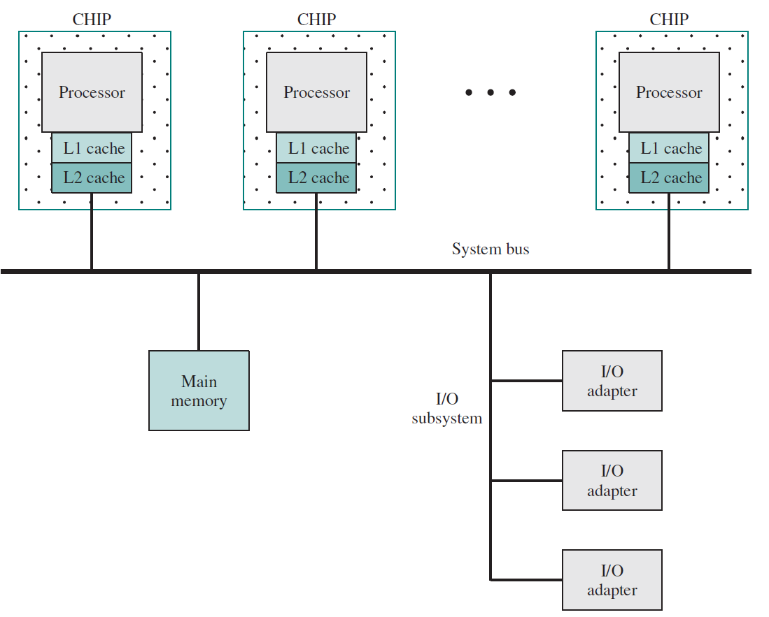
SMP Organization
Notes:
Figure 1.19 illustrates the general organization of an SMP. There are
multiple processors, each of which contains its own control unit, arithmetic-logic unit, and registers. Each processor typically has two dedicated levels of cache, designated L1 and L2.
As Figure 1.19 indicates, each processor and its dedicated caches are
housed on a separate chip. Each processor has access to a shared main memory and the I/O devices through some form of interconnection mechanism; a shared bus is a common facility. The processors can communicate with each other through memory (messages and status information left in shared address spaces). It may also be possible for processors to exchange signals directly. The memory is often organized
so multiple simultaneous accesses to separate blocks of memory are possible.
In modern computers, processors generally have at least one level of cache memory that is private to the processor. This use of cache introduces some new design considerations. Because each local cache contains an image of a portion of main memory, if a word is altered in one cache, it could conceivably invalidate a word in another cache. To prevent this, the other processors must be alerted that an update
has taken place. This problem is known as the cache coherence problem, and is typically addressed in hardware rather than by the OS.

Slide 48
SMP Advantages
Performance
a system with multiple processors will yield greater performance if work can be done in parallel
Availability
the failure of a single processor does not halt the machine
Incremental Growth
an additional processor can be added to enhance performance
Scaling
vendors can offer a range of products with different price and performance characteristics
These are potential, rather than guaranteed, benefits
An attractive feature of an SMP
the existence of multiple processors is transparent to the user.
OS takes care of task scheduling and synchronization
Notes:
An SMP organization has a number of potential advantages over a uniprocessor organization, including the following:
• Performance: If the work to be done by a computer can be organized so that some portions of the work can be done in parallel, then a system with multiple processors will yield greater performance than one with a single processor of the same type.
Availability: In a symmetric multiprocessor, because all processors can perform the same functions, the failure of a single processor does not halt the machine. Instead, the system can continue to function at reduced performance.
• Incremental growth: A user can enhance the performance of a system by adding an additional processor.
• Scaling: Vendors can offer a range of products with different price and performance characteristics based on the number of processors configured in the system.
It is important to note that these are potential, rather than guaranteed, benefits. The operating system must provide tools and functions to exploit the parallelism in an SMP system. An attractive feature of an SMP is that the existence of multiple processors is transparent to the user. The operating system takes care of scheduling of tasks on individual processors and of synchronization among processors.

Slide 49
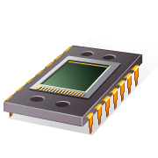
Multicore Computer
Also known as a chip multiprocessor
Combines two or more processors (cores) on a single piece of silicon (die)
each core consists of all of the components of an independent processor
In addition, multicore chips also include L2 cache and in some cases L3 cache

Slide 50
Summary
Process/related to resource ownership
Thread/related to program execution
Types of threads: User-level threads and kernel-level threads
Symmetric Multiprocessors (SMP)

Slide 51

Next Topic
Concurrency: Mutual Exclusion and Synchronization
Read Ch. 5

